Slide 1
Data-informed way of traveling Rome

Slide 2
Introduction
Problem Statement: Doing research for travel is a pain, people do not want to spend that much time to search for everything but they fear missing out on the amazing adventure they could be having.
Solution: We provide a easy and automated analysis for the best locations to visit when in Rome. It does not require extensive Googling (Yes, it's a verb!) and documenting in Excel.¶

Slide 3
Data Acquisition
Nominatim: We will use it to convert address to lat/long coordinates as the starting point for generating our grid.
Foursquare API: we will extract 50 local food places per each circle, radius = 1/2 length of the square on the grid
Google API: we will extract the user ratings and price level for each of the food places

Slide 4
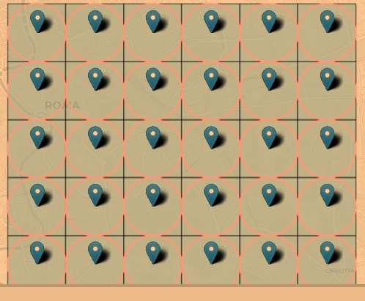
Creating a 6X6 grid (width=1.5km)

Slide 5
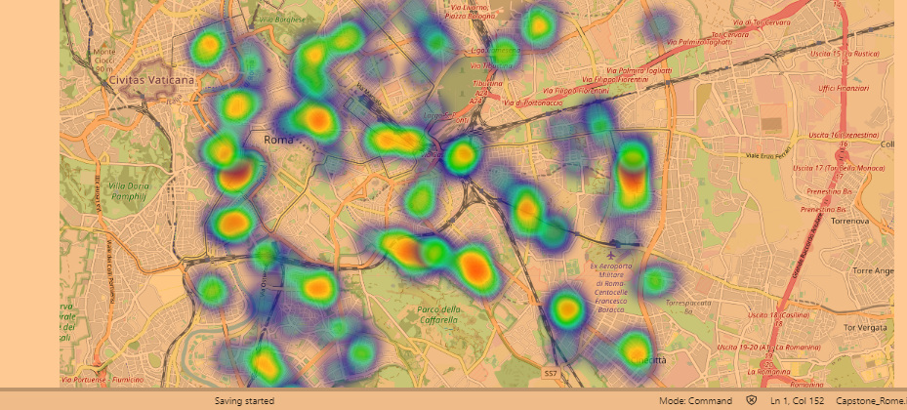
Heatmap of locations with >4.5 ratings on Google Maps

Slide 6
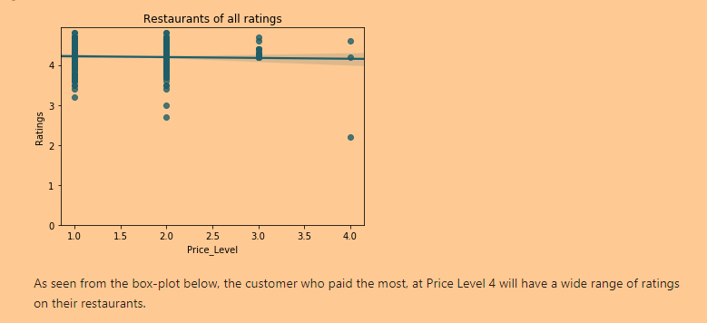
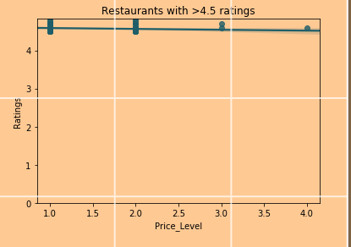
Very weak negative correlation between Price and User-rating

Slide 7
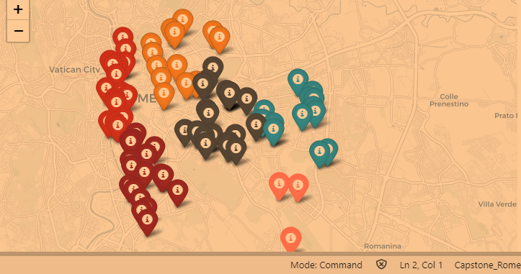
Cluster >4.5 Rating Restaurants Based on Location

Slide 8
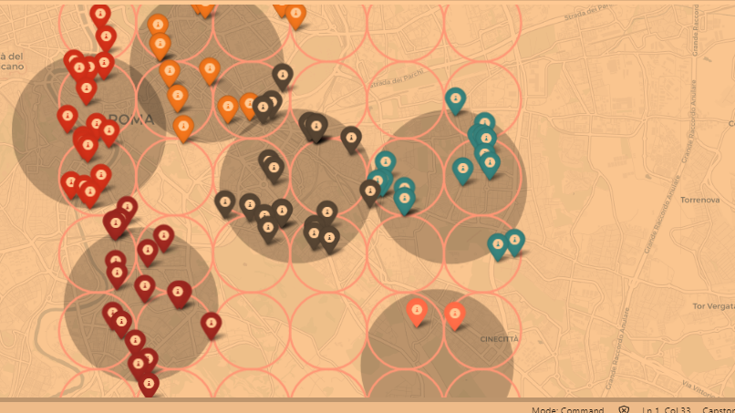
Red Marker Area: Middle to high-end restaurants Mostly Italian Restaurants Gray Marker Area: Budget restaurants Mostly Exotic-flavors Orange Marker Area: Medium level price range Mostly Italian Restaurants

